Slide 1
Data Analysis Project 2 Emotion Analysis
SUPERVISED BY:-
MR.RANJAN KUMAR
SUBMITTED BY:-
RAVI SHANKAR
BATCH-5132

Slide 2
Problem Statement
Emotion dataset is a dataset which is used to do sentiment analysis
Task:- find the emotions from human sentiments , here we predict the emotion and check the accuracy of prediction by using machine learning algorithms. Collection of documents and its emotions, It helps greatly in NLP Classification tasks
Content sentiment and emotion. Dataset is split into train & test for building the machine learning model
Example :- i feel like I am still looking at a blank canvas blank pieces of paper; sadness
Using ALogorithms are:
Multinomial Naive Baise
Random Forest Classifier

Slide 3
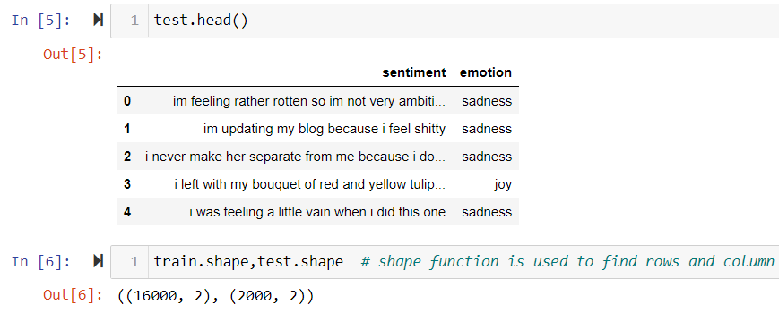
Train Data

Slide 4
Test Data

Slide 5
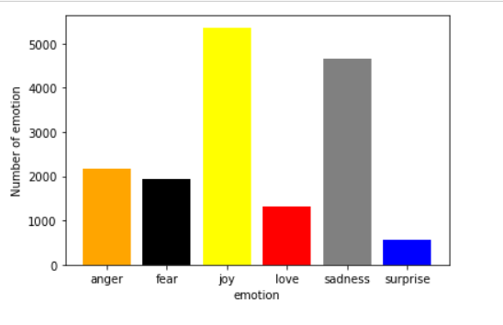
Bar Plot Graph This bar plot graph is represent 1. The count of each emotion 2. Diffrent colorbars represent different emotion 3. There are six emotions three emotions are good for health and rest three emotion are bad for health.

Slide 6
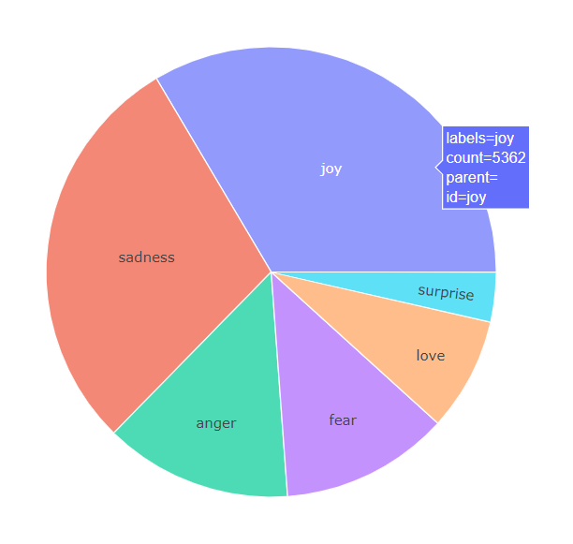
Pie Chart this graph shows in pie chart form:- 1. It represent the count and percent of emotion in dataset 2. This graph says the count of joy is max and second max value is sadness . this represent that joy is most common emotion in the dataset this is better for each person. 3. The sadness is second max emotion it means most of time human mood swings in between joy and sadness feeling. 4. mostly person dont get surprise oftenly thats why the percenatge of surprise is very less.

Slide 7
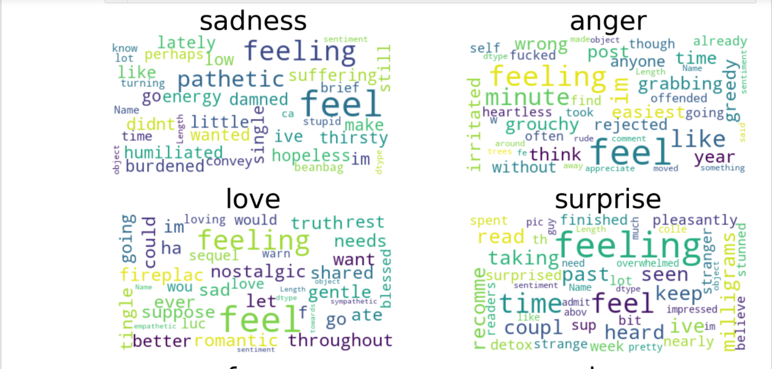
Word cloud

Slide 8
Text Cleaning Technique:-
Tokenization:-Tokenization is essentially splitting a phrase, sentence, paragraph, or an entire text document into smaller units, such as individual words or terms. Each of these smaller units are called tokens.
POS tagging:-It is a process of converting a sentence to forms – list of words, list of tuples (where each tuple is having a form (word, tag)).
lemmatization:-Lemmatization usually refers to doing things properly with the use of a vocabulary and morphological analysis of words, normally aiming to remove inflectional endings only and to return the base or dictionary form of a word, which is known as the lemma
stemming:-Stemming is basically removing the suffix from a word and reduce it to its root word
stopwords:-In NLP and text mining applications, stop words are used to eliminate unimportant words, allowing applications to focus on the important words instead.

Slide 9
Multinomial Naïve Bayes
Multinomial Naive Bayes algorithm is a probabilistic learning method that is mostly used in Natural Language Processing (NLP).
After apply MultinomialNB
MultinomialNB Accuracy: 0.6603703703703704

Slide 10
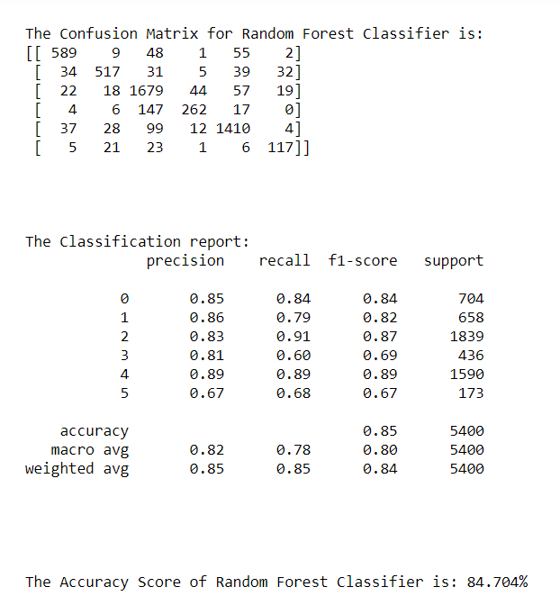
Random Forest Classifier Accuracy is 84.704% which is really better than multinomial naive bayes.

Slide 11
Conclusion
Here we use two machine learning algorithm
1. Multinomial naïve Bayes
2. Random Forest Classifier
We get the higher accuracy in Random Forest Classifier Algorithm than MultinomialNB is 84.407%.

